Slide 1
Co-management and Tenant Attach in Configuration Manager
Ben Whitmore & Paul Winstanley

Slide 2
Split Session First Half
Co-management
Ben Whitmore
Discuss prerequisites and concepts of co-management. Look at enrolment in a bit more detail and demonstrate how to move workloads to Intune
Notes:
Walk through the prerequisites and concepts of co-management
Look at enrolment in a bit more depth
Demonstrate how to move workloads to Intune
Things to consider

Slide 3
Split Session Second Half
Tenant Attach
Paul Winstanley
Demonstrate how you can Tenant Attach your ConfigMgr instance and start to bring that ConfigMgr goodness into the Endpoint Manager console

Slide 4

Ben Whitmore
Current Role: Technical Architect (GOV)
Residence: United Kingdom
Experience: 20 years
Technology: CCNA, ADDS, Exchange, Office, SFB, Datacentre, VMware, Veeam, OSD, Windows, AAD, MEM
Blog: byteben.com

Slide 5
Co-management
What is Co-management
Paths to Co-management
Prerequisites
Enrolling Clients
Moving Workloads
Considerations
Notes:
In this ession we will be looking at
What is Co-management (and what it is not)
How do we get to Co-management
Prerequisites
Break into the labs and look at:-
Enrolling Clients bit more detail
Moving Workloads
Considerations and “Gotchas”

Slide 6

What is Co-management
Notes:
Co-management is a technology that “harmonizes” workload and policy delivered from both Intune and ConfigMgr to ensure there are no conflicts
It’s a way to bridge on-prem with cloud management and allows a phased approach to moving to modern management
Before co-mgmt., it was always a battle when trying to do stuff in Intune on existing ConfigMgr clients. You would often get conflicting policies and when trying to apply a mix of settings from both environments. Co management ensures that policy and configuration, for specific workloads, come from one, authorative, source and that could be wither Intune or COnfigMg
Applicable to Windows 10.

Slide 7
What is Co-management
Immediate “Cloud Value”
Device Wipe
Factory reset
Application Deployment
Auditing and Security
Client Health
Notes:
Co-mgmgt brings immediate Cloud value to Windows 10 devices that re managed by ConfigMgr. When a device is enrolled into Intune we get the following features straight away
Device Wipe
Factory reset
Application Deployment
Auditing and Security
Client Health

Slide 8


What is Co-management
Enable Compliance-based conditional access for on premise clients
Block access to cloud services based on device compliance
***EASY WIN***
Notes:
One of the more obvious “Easy Wins” that comes from co-managing Windows 10 devices is Compliance Based Conditional Access
Being able to block access to cloud services based on the Device Compliance is very powerful and should not be underestimated

Slide 9
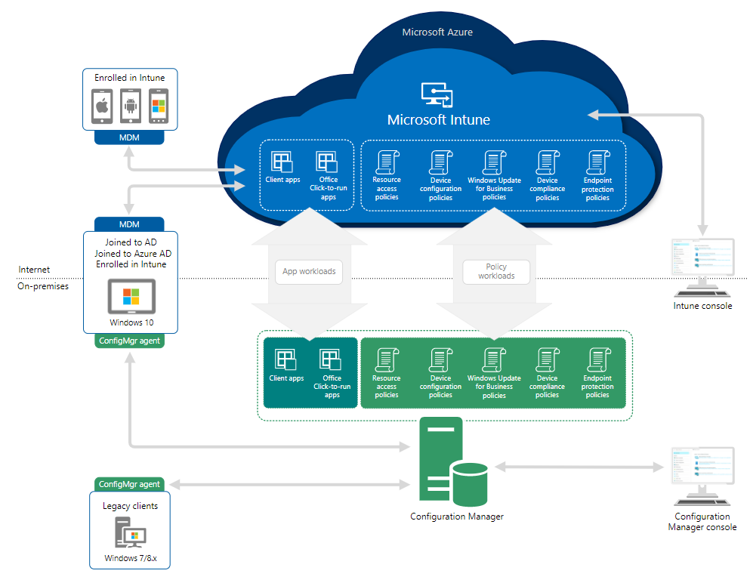
Notes:
This is what the co-mgmt flow looks like
Two management platforms, Intune and ConfigMgr “working together”
It IS NOT
Hybrid
Policies were created in ConfigMgr and then synced to Intune. Intune then applied the policies to the devices. This feature was deprecated in September 2019
Co-Existence
When you have a 3rd Party MDM installed on your clients. ConfigMgr will go into Read Only mode when a 3rd Party MDM is found. The agent will be able to perform basic tasks like such as HINV, Software Metering and Reporting.
In blue we have our modern management / cloud environment where we typically manage mobile devices and AAD Joined Device
In green we have our traditional ConfigMgr environment.
Legacy clients are not in scope for comgmt
Windows 10 clients have the configmgr and Windows 10 MDM agent installed.
Workloads, which we will look at in more detail a bit later, are moved from the configmgr side – the agents communicate to dictate if the policy from Intune or ConfigMgr will apply
There are 7 workloads which can be handled in a co-mgmt. scenario.
Client Apps
Office Click to Run Apps
Resource Access Policies
Device Configuration Policies
WU Policies
Device Compliance Policies
End Point Protection Policies

Slide 10
Paths to Co-management
There are two main paths to reach co-management
Existing Configuration Manager clients
Windows 10 devices already managed by Configuration Manager
Internet Enrolled Clients
Windows 10 devices that are Azure AD Joined and managed by Intune
Notes:
How do we get to a comanaged state?
Existing Configuration Manager clients
Windows 10 devices already managed by Configuration Manager. Requires Azure AD Registration and Intune enrolment.
Internet Enrolled Clients
Windows 10 devices that are Azure AD Joined and managed by Intune. Requires the Configuration Manager client to be installed and a Cloud management Gateway
Most common scenario for co-mgmt is for existing configmgr clients moving workloads to Intune

Slide 11
Prerequisites
Pathway: Existing Configuration Manager clients
Licensing
Azure Active Directory (Azure AD)
Windows 10
Permissions and Roles
Configuration Manager
Notes:
1. Azure AD Premium P1 or P2 (Both Included with Microsoft 365 E3/E5 and Enterprise Mobility & Security (EMS) E3/E5) + Intune
2. Windows 10 devices must be registered in or joined to AAD.
Device state must be either: -
Hybrid Joined (AAD Registered) or Azure AD Joined
3. Windows 10 devices 1709+
Devices must be able to access: -
device.login.microsoftonline.com (443)
enterpriseregistration.windows.net (443)
login.microsoftonline.com (443)
4. Global Administrator - to configure the co-management service
ADDS Enterprise Administrator - to setup SCP for Hybrid AAD during AAD Connect Setup Wizard
ConfigMgr Administrator (with all roles in scope)
5. ConfigMgr
6. MDM User Scope set to All or Some
(Some requires the users who will be enrolling devices into Intune to be included in the scope)

Slide 12
Prerequisites 5. Configuration manager
1710
1806
3 new workloads - Device Configuration, Office 365, Client Apps
1906
Device enrols to Intune with AAD Device Token Multiple Pilot Groups for workloads
1910
Connected Cache support for Intune Win32Apps.
2006
Azure China 21Vianet
Notes:
1710 – CoMgmt Introduced
1806
3 new workloads - Device Configuration, Office 365, Client Apps. Support for multiple ConfigMgr hierarchies in a single Intune tenant
1810
Although no on the slide, Version 1810 introduced a simpler command line for internet-based installation of the Configuration Manager client.
1906
Device enrols to Intune with AAD Device Token. Multiple Pilot Groups for workloads. Support for Gov Cloud.
1910
Connected Cache support for Intune Win32Apps.
2006
You can now select the Azure China Cloud as your Azure environment when enabling co-management

Slide 13
Prerequisites
Licensing
Azure Active Directory (Azure AD)
Windows 10
Permissions and Roles
Configuration Manager
Microsoft Intune
Notes:
1. Azure AD Premium P1 or P2 + Intune
2. Windows 10 devices must be registered or joined to AAD.
3. Windows 10 devices 1709+
Devices must be able to access: -
device.login.microsoftonline.com (443)
enterpriseregistration.windows.net (443)
login.microsoftonline.com (443)
4. Global Administrator - to configure the co-management service
ADDS Enterprise Administrator - to setup SCP for Hybrid AAD during AAD Connect Setup Wizard
ConfigMgr Administrator (with all roles in scope)
6. MDM User Scope set to All or Some
(Some requires the users who will be enrolling devices into Intune to be included in the scope)

Slide 14
Hybrid AAD Join / Enrolling Clients
Notes:
I want to spend some time looking in more detail at the enrolment process for devices into Intune. Spoiler – let ConfigMgr do it.
Before a Domain Joined Computer can enrol into Intune we need to ensure that it is Azure AD Registered
The easiest way to facilitate this is by configuring Hybrid Azure AD Join which can be enabled using Azure AD Connect

Slide 15
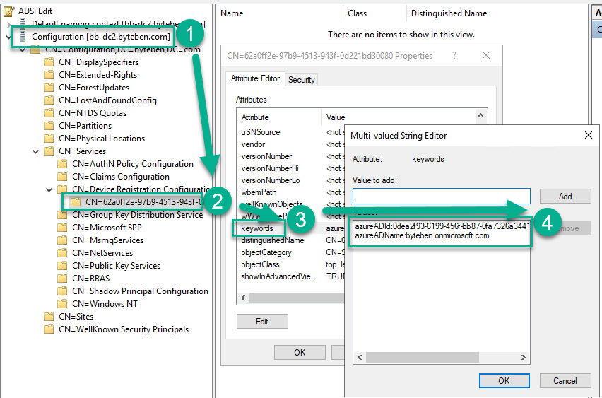
Hybrid AAD Join
Notes:
Effectively what happens when Hybrid AAD Connect is configured, the wizard publishes the Azure AD tenant information to a Service Connection Point (or SCP) in ADDS
CN=62a0ff2e-97b9-4513-943f-0d221bd30080
Domain Joined Windows 10 clients will query this information and automatically register with Azure AD.

Slide 16
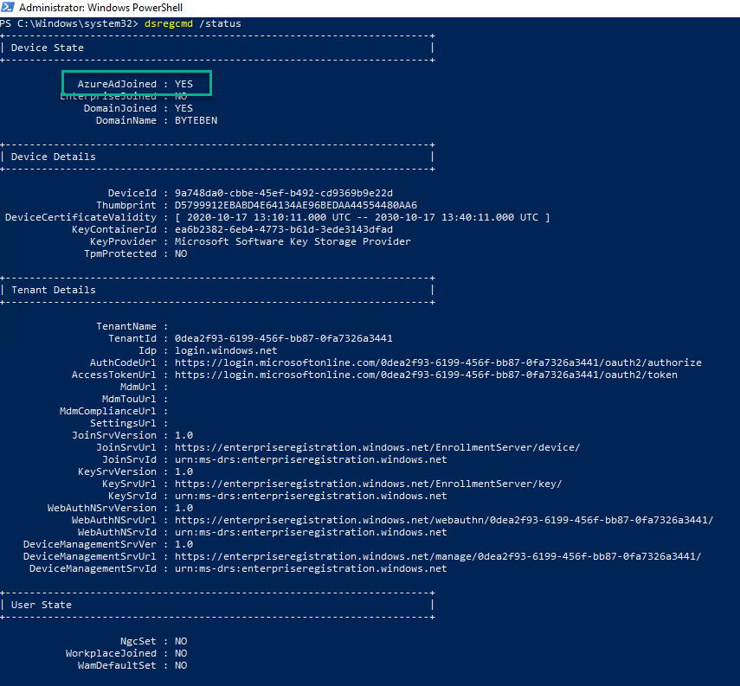
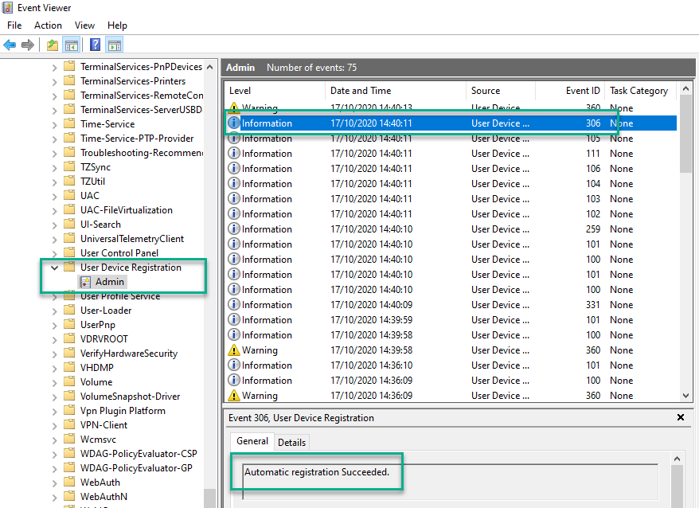
Hybrid AAD Join
dsregcmd /status
Notes:
demo dsregcmd /status
Show device registration in Azure AD Device

Slide 17
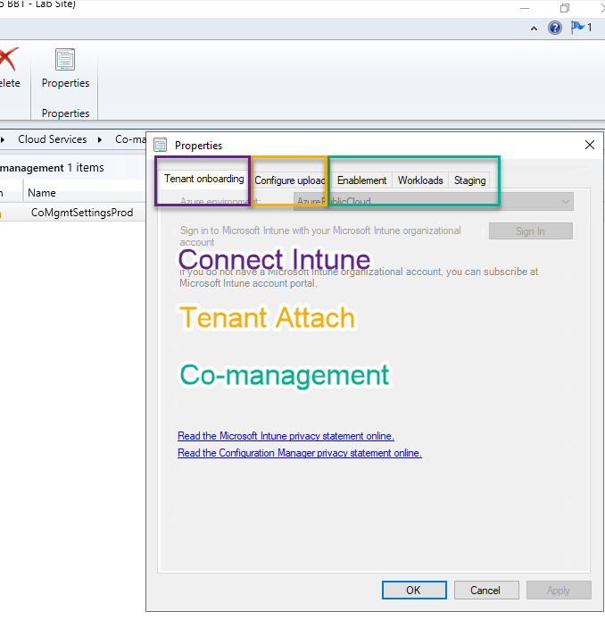
Enrolling Clients
Notes:
Co-Management is a Cloud Service Configured in “Cloud Management” under “Administration – Cloud Services
Another cloud service to enable could be group sync
TIP: Show Group Sync in Lab?
Show labs for enrolment
Automatic enrolment isn't immediate for all clients. This behaviour helps enrolment scale better for large environments. Configuration Manager randomizes enrolment based on the number of clients. For example, if your environment has 100,000 clients, when you enable this setting, enrolment occurs over several days.
TIP: Use ConfigMgr Co-management settings to enrol Windows 10 devices to Intune
If you use a GPO the enrolment must take place with the AAD User Token.
ConfigMgr 1906 the AAD Device Token will enrol the device into Intune.
The Primary User will be set to “None” when the AAD Device Token is used for enrolment
The next User to log on to the device becomes the “Enrolled by user”. This means any synced, hybrid Identity, not necessarily a user with an Intune licence. If your admins “touch” devices before the device is handed to the user, ensure the identity they log on with is excluded from Directory Synchronization

Slide 18
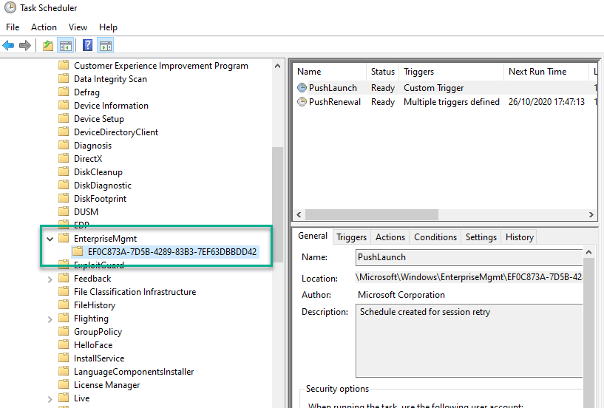
Enrolling Clients – A little deeper
Task is created when a policy is received

Slide 19
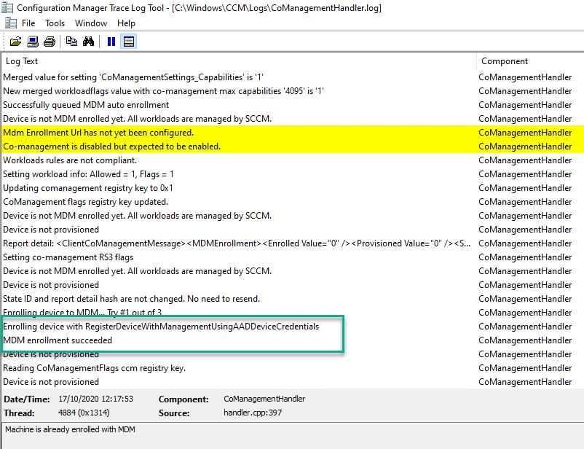
Enrolling Clients – A little deeper
CoManagementHandler.log
Indicates that MDM enrolment succeeded with the AADDeviceToken

Slide 20
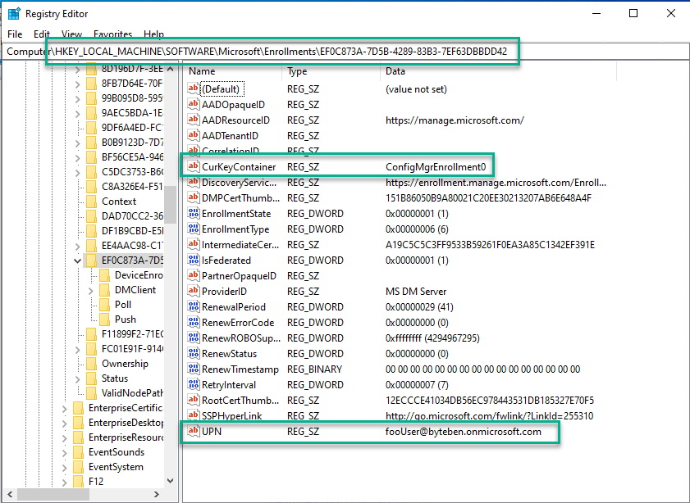
Enrolling Clients – A little deeper
The client registry will indicate that enrolment was performed by ConfigMgr and the UPN will be
fooUser@<tenantname>.onmicrosoft.com

Slide 21
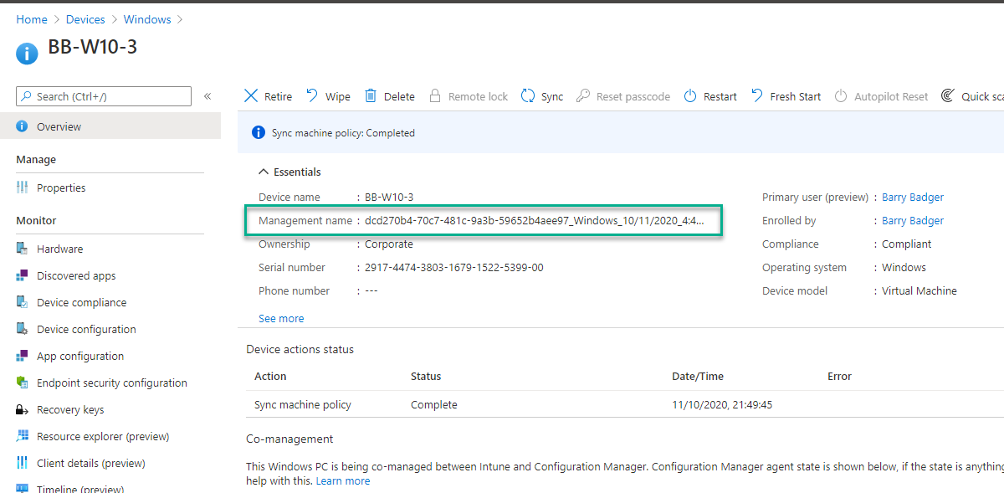
Enrolling Clients – A little deeper
The Management name in Intune is derived from the Azure AD DeviceID when ConfigMgr enrols the device

Slide 22
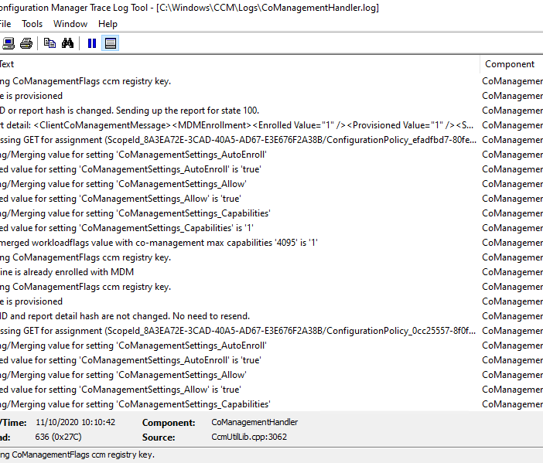
Moving Workloads
Today, there are 7 workloads available in ConfigMgr
Compliance policies
Windows Update policies
Resource access policies
Endpoint Protection
Device configuration
Office Click-to-Run apps
Client apps

Slide 23
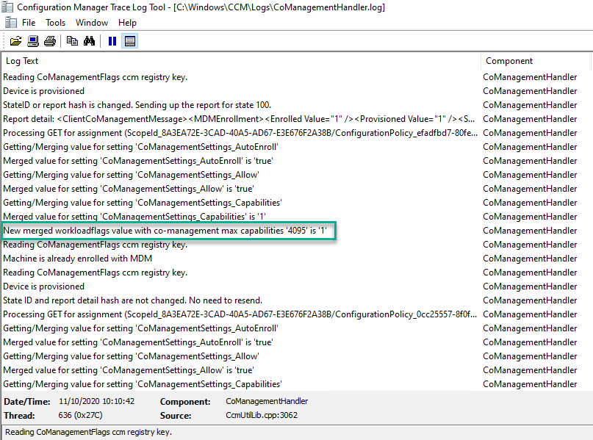
Moving Workloads
Workloads are calculated on the Client by merging a unique capability number which represents each workload
Notes:
1 Indicates no workloads have been moved to Intune yet

Slide 24
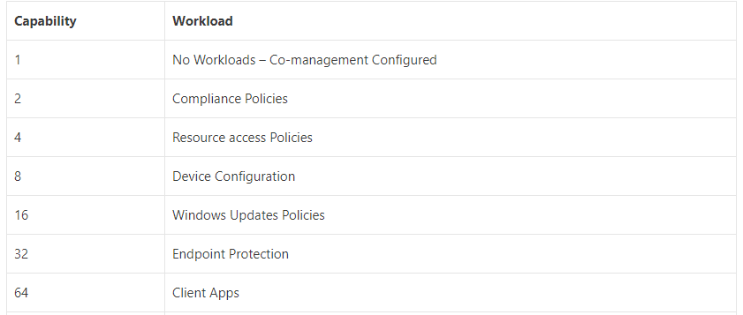
Moving Workloads
Notes:
Workload values

Slide 25
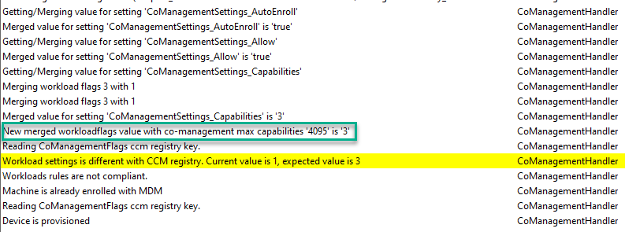
Moving Workloads
The above log indicates the Compliance Workload has been moved to Intune for this client. The Capabilities are “merged”.
1 (co-management configured) + 2 (Compliance) = Capabilities Value 3

Slide 26
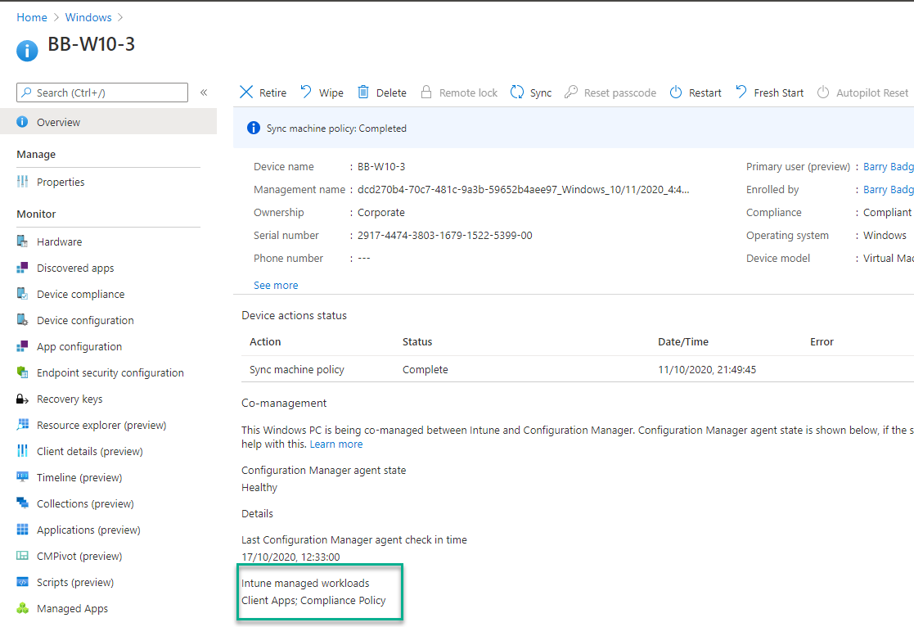
Moving Workloads
The Microsoft Endpoint Manager Admin Centre will also indicate which workloads have been moved to Intune
Notes:
After the capabilities are merged, an MDM Sync occurs. This allows the client to check for Intune Policies for the workloads that have been assigned to it.

Slide 27
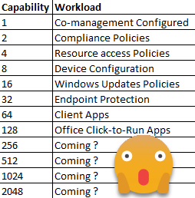
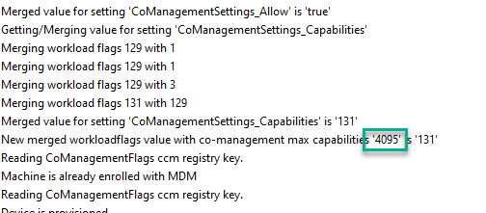
Moving Workloads
The maximum capabilities value was 255 (all 7 workloads moved to Intune)
New maximum capability value is 4095
Notes:
2 ^ 0 = 1 = No Workloads
2 ^ 1 = 2 = Compliance Policies
2 ^ 2 = 4 = Resource Access Policies
2 ^ 3 = 8 = Device Configuration
2 ^ 4 = 16 = Windows Update Policies
2 ^ 5 = 32 = Endpoint Protection
2 ^ 6 = 64 = Client Apps
2 ^ 7 = 128 = Office Click-2-Run Apps
2 ^ 8 = 256 = ?
2 ^ 9 = 512 = ?
2 ^ 10 = 1024 = ?
2 ^ 11 = 2048 = ?

Slide 28

Considerations for Workloads
Consider any legacy settings that may impact a successful workload move
Consider any Intune settings that the device will suddenly be in scope for as the workload is moved
Test on a pilot group
Consider implementing a CMG.. Seriously!

Slide 29
Real world Gotchas
Windows Updates Disabled
https://byteben.com/bb/using-memcm-to-fix-legacy-gpo-settings-that-prevent-co-managed-clients-getting-updates-from-intune/
Edge Updates Disabled
https://byteben.com/bb/microsoft-edge-stops-receiving-updates-after-the-windows-update-workload-is-moved-to-intune/
Office 365 Updates still set to use Office MgmtCOM
https://byteben.com/bb/office-365-updates-stop-working-when-workloads-are-switched-to-intune/
Notes:
https://docs.microsoft.com/en-us/mem/intune/fundamentals/deployment-guide-intune-setup

Slide 30


Paul Winstanley
Current Role: MEM Consultant
Residence: United Kingdom
Experience: 25 years
Technology: MEM
Blog: sccmentor.com

Slide 31
Tenant Attach
Attach your ConfigMgr instance to the cloud
Simple to implement
ConfigMgr 2002 as a minimum
A global admin is needed when setting up the services.
An Azure public cloud environment

Slide 32
Tenant Attach Pre-Reqs
User account triggering the device actions to have the following:
Discovered with both AAD user discovery and Active Directory user discovery
The Initiate Configuration Manager action permission under Remote tasks in the Microsoft Endpoint Manager admin center.
Access to Internet Endpoints

Slide 33
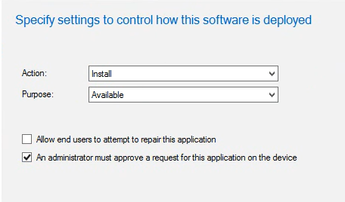
Tenant Attach
Applications Pre-Reqs:
The Approve permission for Application in Configuration Manager.
Microsoft Edge v77 or later or Google Chrome
Read permissions on the device’s collection in ConfigMgr
The Read permission for Application in ConfigMgr.
Added as an admin user in the Configuration Manager Microservice application in Azure AD.

Slide 34
Tenant Attach Troubleshooting
Check the logs:
Adminservice.log
CMGatewayNotificationWorker.log
SMS_REST_PROVIDER.log
Check permissions are set up in accordance with docs
Check access to MS endpoints
Check rights to ConfigMgr microservice
Notes:
Verify the service connection point has connectivity to the cloud using the CMGatewayNotificationWorker.log.
Verify the administrative service is healthy by reviewing the SMS_REST_PROVIDER component from site component monitoring on the central site.
IIS must be installed on provider machine. For more information, see Prerequisites for the administration service.
Verify the clock on the service connection point is in sync. If the service connection point's clock is slightly behind, apply KB4563473 - Update rollup for Configuration Manager version 2002 tenant attach issues. Check AdminService.log on the provider machine for any errors.

Slide 35
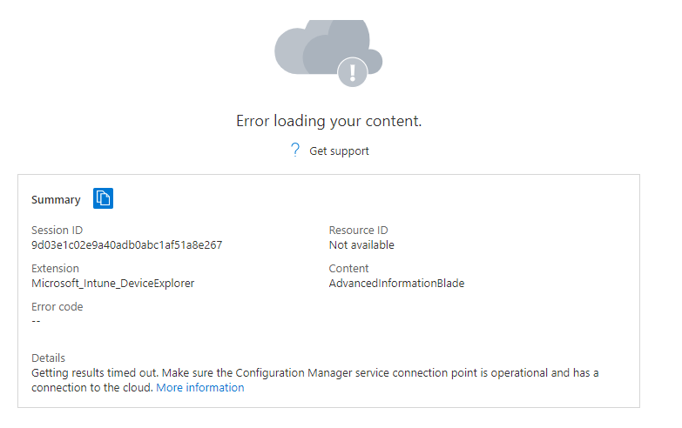
Tenant Attach

Slide 36
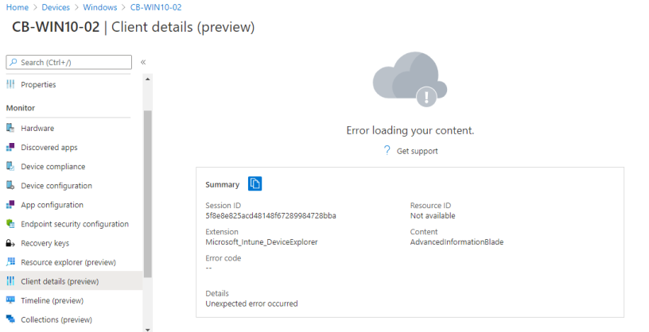
Tenant Attach

